Slide 1
Politik Lingkungan

Slide 2
Hello!
Welcome to the class

Slide 5
Mata kuliah ini hadir dalam rangka merespon perkembangan ilmu politik di masa mendatang dimana isu lingkungan merupakan salah satu isu utama dalam aras global

Slide 6
Apa itu Politik Lingkungan?

Slide 7
Carter (2007)
Environmental politics is a wide-ranging subject with three core components:
The study of political theories and ideas relating to the environment
The examination of political parties and environmental movements
The analysis of public policymaking and implementation affecting the environment at international, national and local levels

Slide 8
Big concept
One distingushing characteristic is that environmental politics has a primary concern with the relationship between human society and the natural world

Slide 9
In other form, there is a political ecology
What is it?
The term political ecology is a generous one that embraces a range of definitions. Some definitions stress political economy, while other point to more formal political institutions; some stress environmental change, while others emphasize narratives or stories about that change. (Robbins, 2012)

Slide 10
This course will learn about: 1. Human-Nature relation in Political Theory: a Political Perspective on Environmental Issues 2. What is Environmental Issues? 3. Democracy and Environment 4. State and Non-State actors on Environmental Issues 5. Environmental Conflicts and Movements 6. Indigenous People and Environmental Movement 7. Environmental Politics in Indonesia

Slide 11
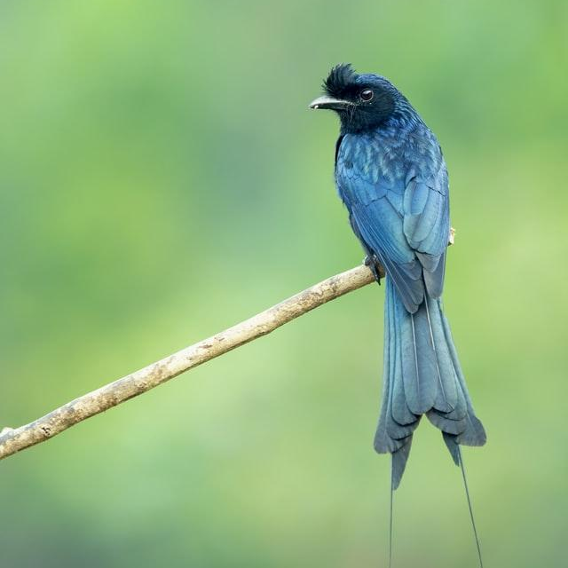
Thanks!

