Slide 1


Introduction & History of Basic Pharmaceuticals
Angga Kautsar
Tim Pengajar Farmasetika Dasar
2026

Slide 2
A. Historical Perspective
Origins of the pharmacist
Pharmaceutical Association
Pharmaceutical law
Development of pharmacopoeia
Weight and size

Slide 3
The Origins of the Pharmacist
Physician at the same time compounding drugs
There is a separation of professions: Physician & pharmacists
Pharmacists are responsible for compounding
The basis of modern pharmaceutical practice

Slide 4
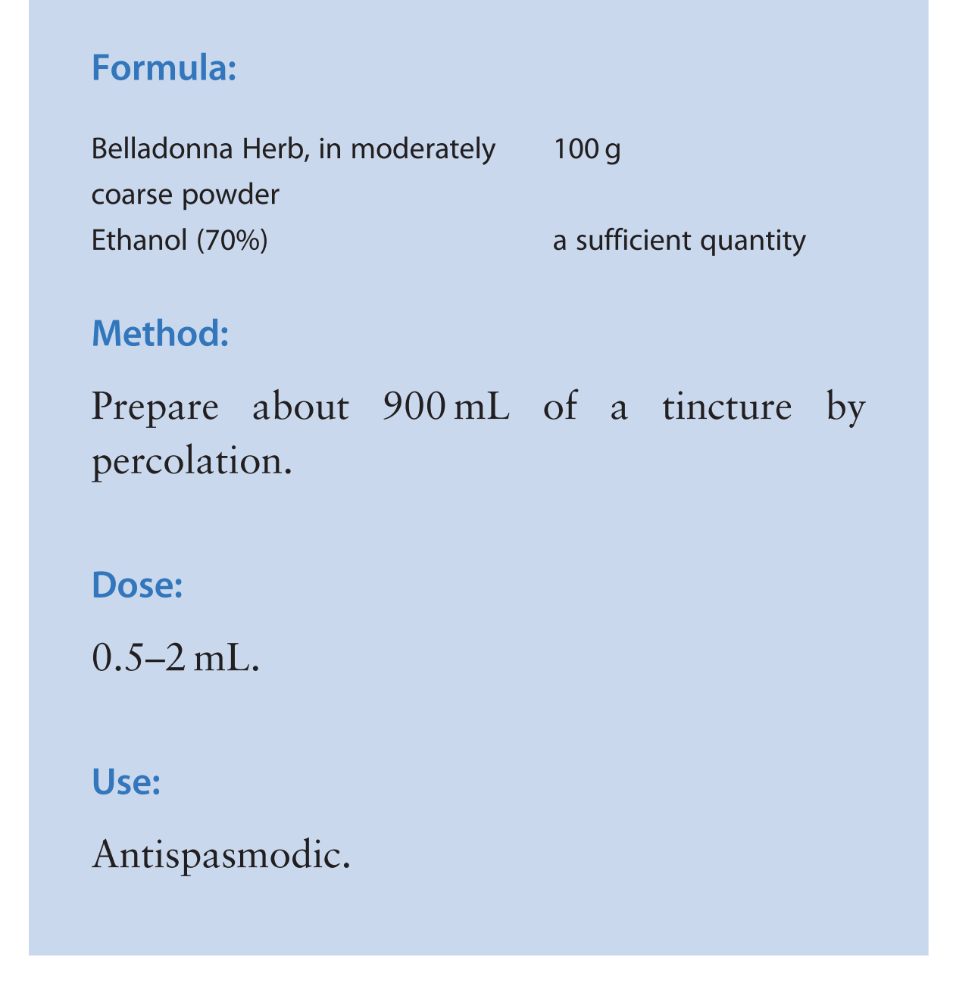
Formula classic

Slide 5
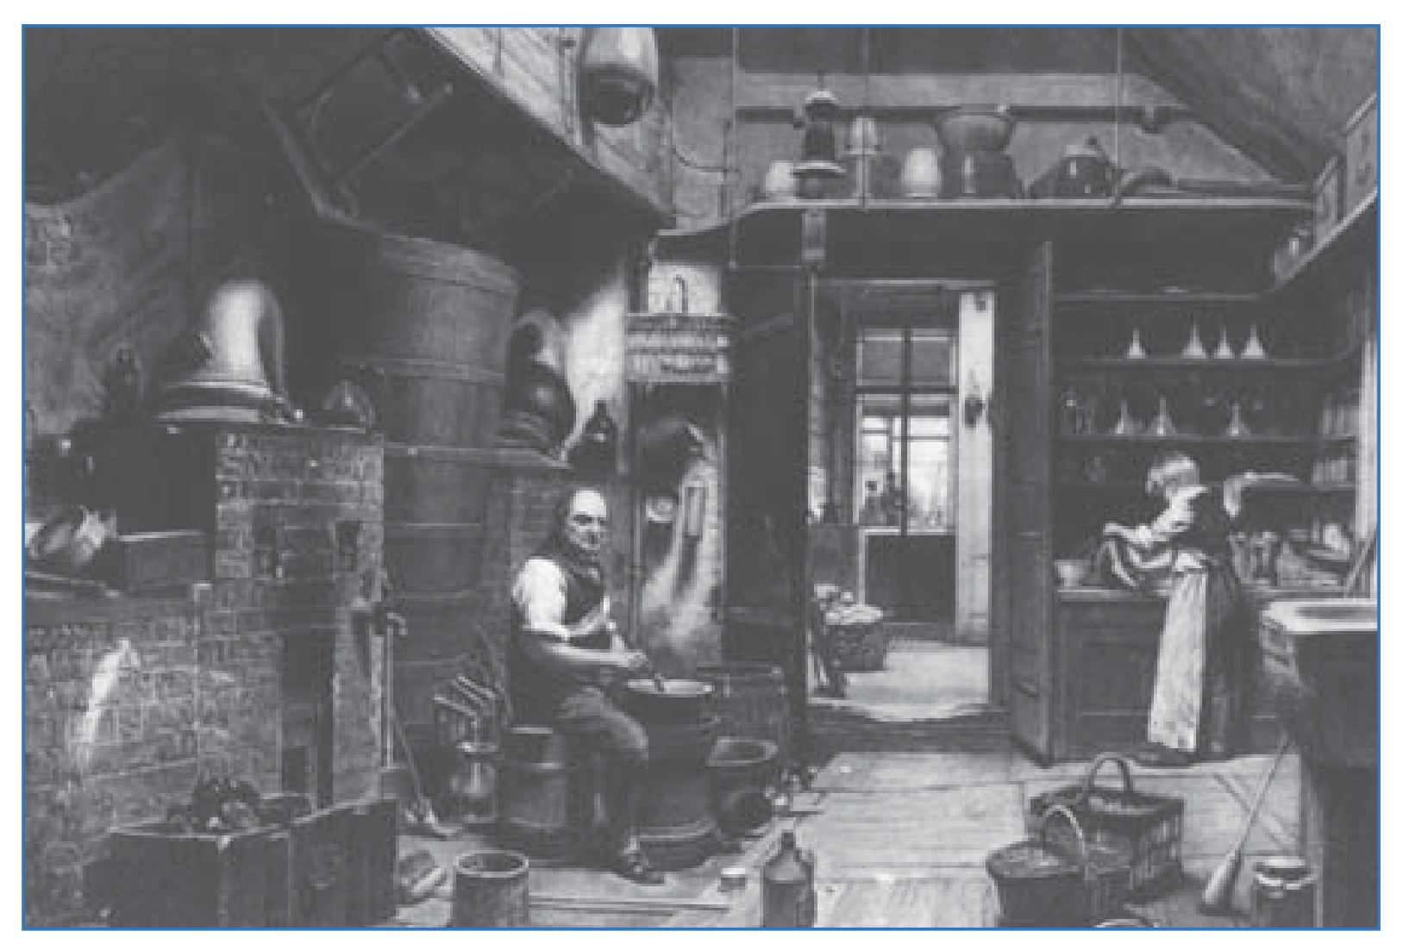
Compounding room

Slide 6
Pharmacopoeia Development
Pharmacopoeia = Official standard of drug quality
  Examples: BP, USP, Indonesian Pharmacopoeia
A reference for laws, regulations, and quality

Slide 7
Weight and Size
Old system: Grain, drum, ounce
  Risk of dosing error
Metric system: gram, mg, mL, litre
  Metrication improves precision

Slide 8
B. Form of Pharmaceutical Preparations and its Preparation
Key formulation skills
Extemporaneous dispensing
Packaging
Storage and labeling requirements

Slide 9
Key Formulation Skills
Weight and size
Calculation of drug strength
Rate and dilution
Weighing and measurement accuracy

Slide 10
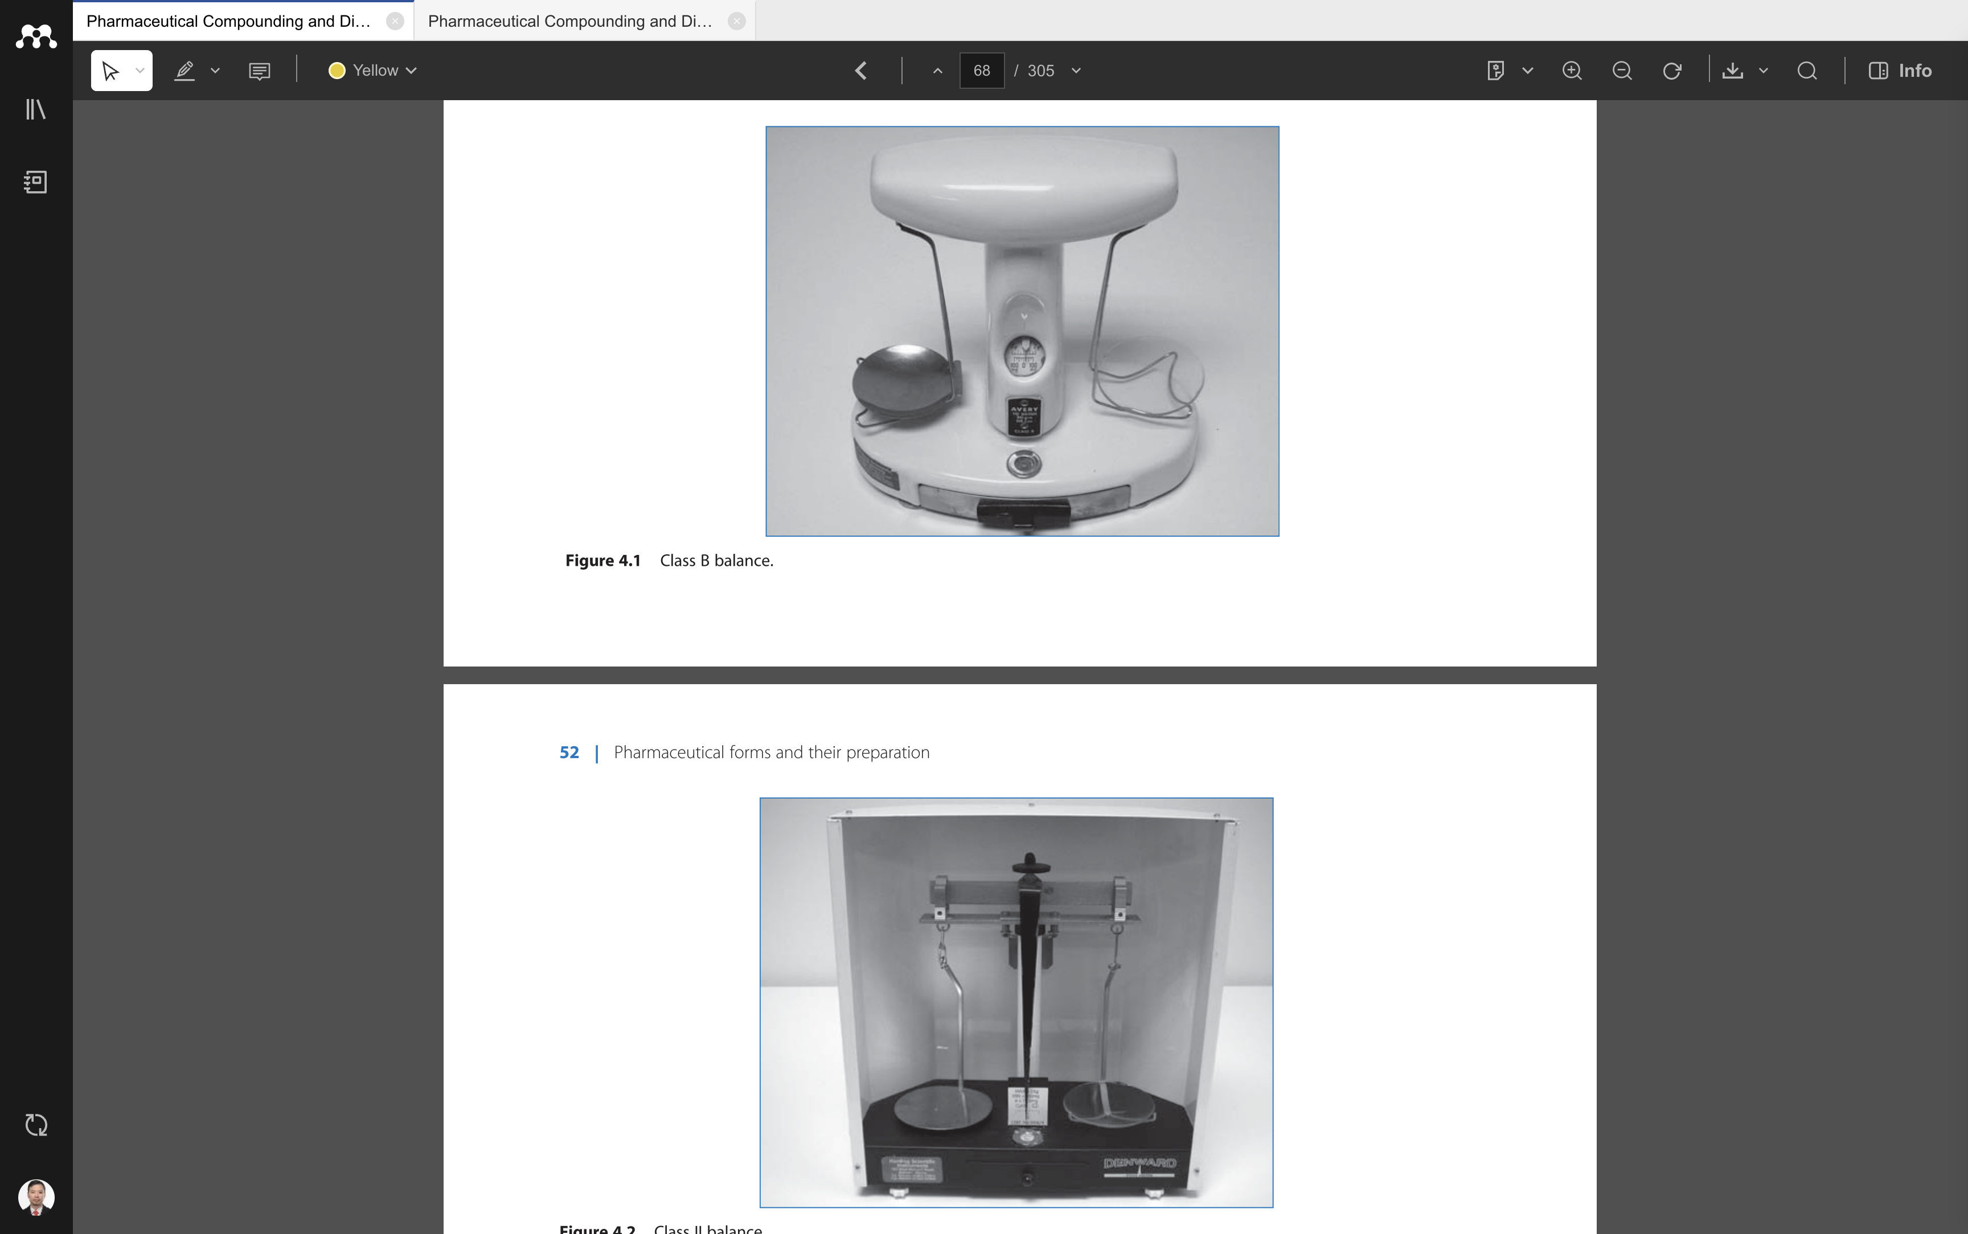
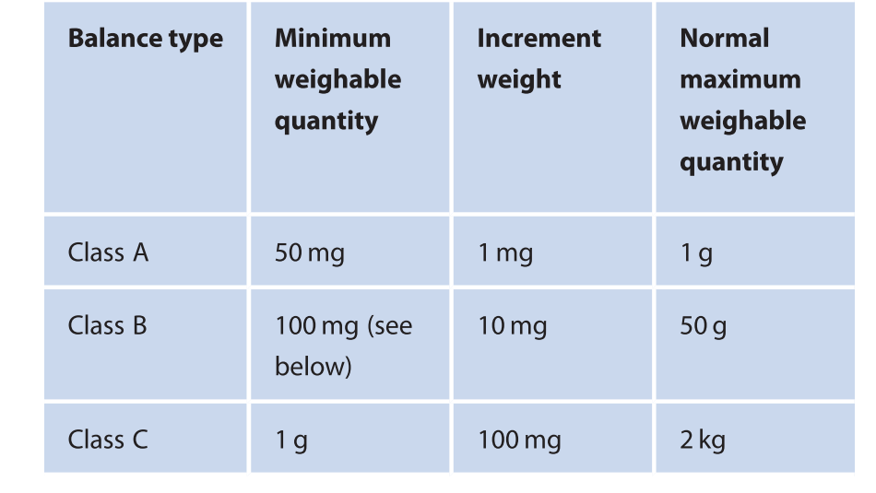
Manual scales

Slide 11
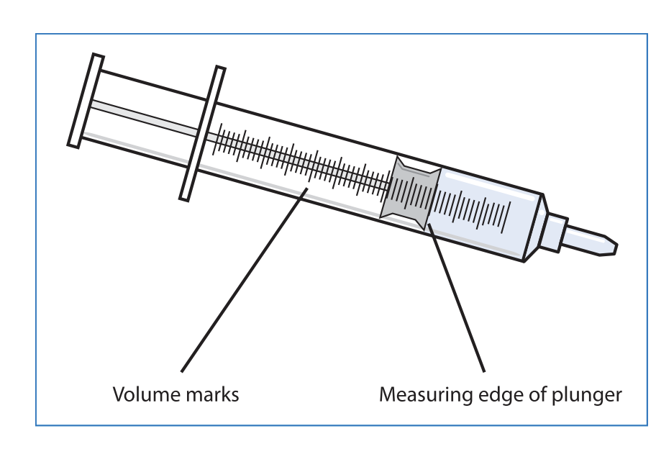
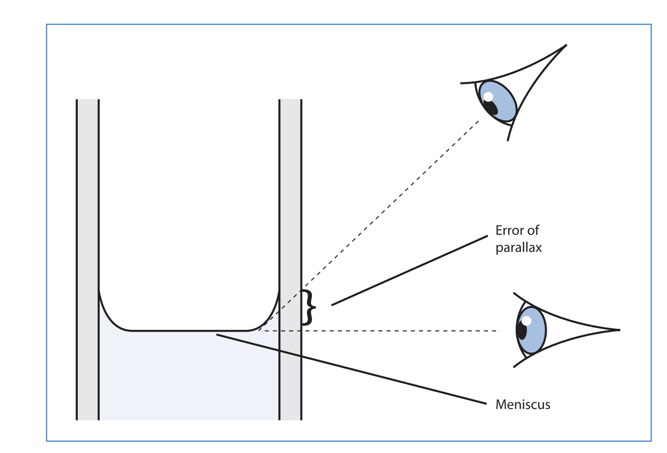
Liquid volume measurement

Slide 12
Medicinal Potency
% w/w, % w/w, % v/v
Strength ratio (1 : 1000)
Dosage calculation for children & adults
  Essential for patient safety

Slide 13
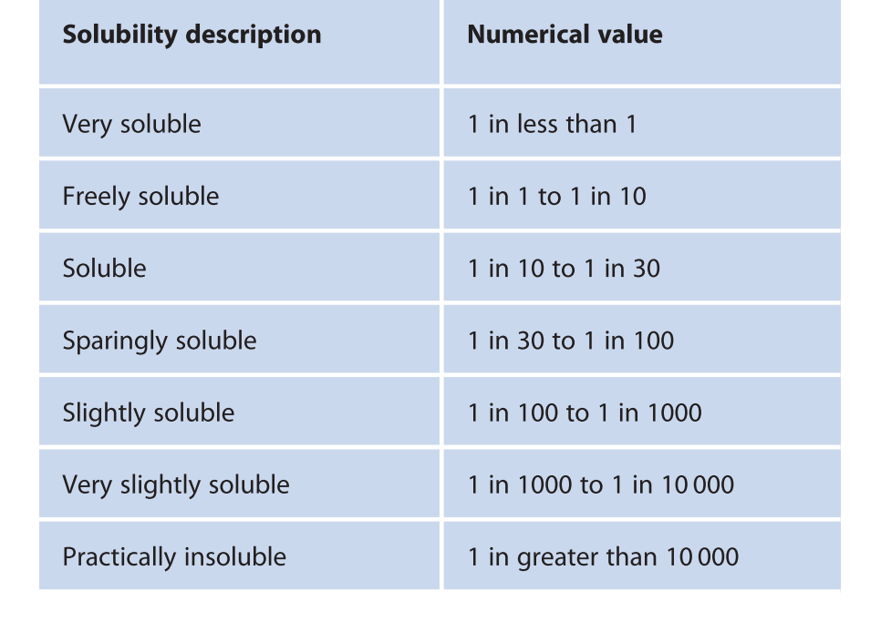

Slide 14
Extemporaneous Dispensing
Compounding of drugs by prescription
Performed for the individual needs of the patient
Requires good documentation
Comply with pharmaceutical practice standards

Slide 15
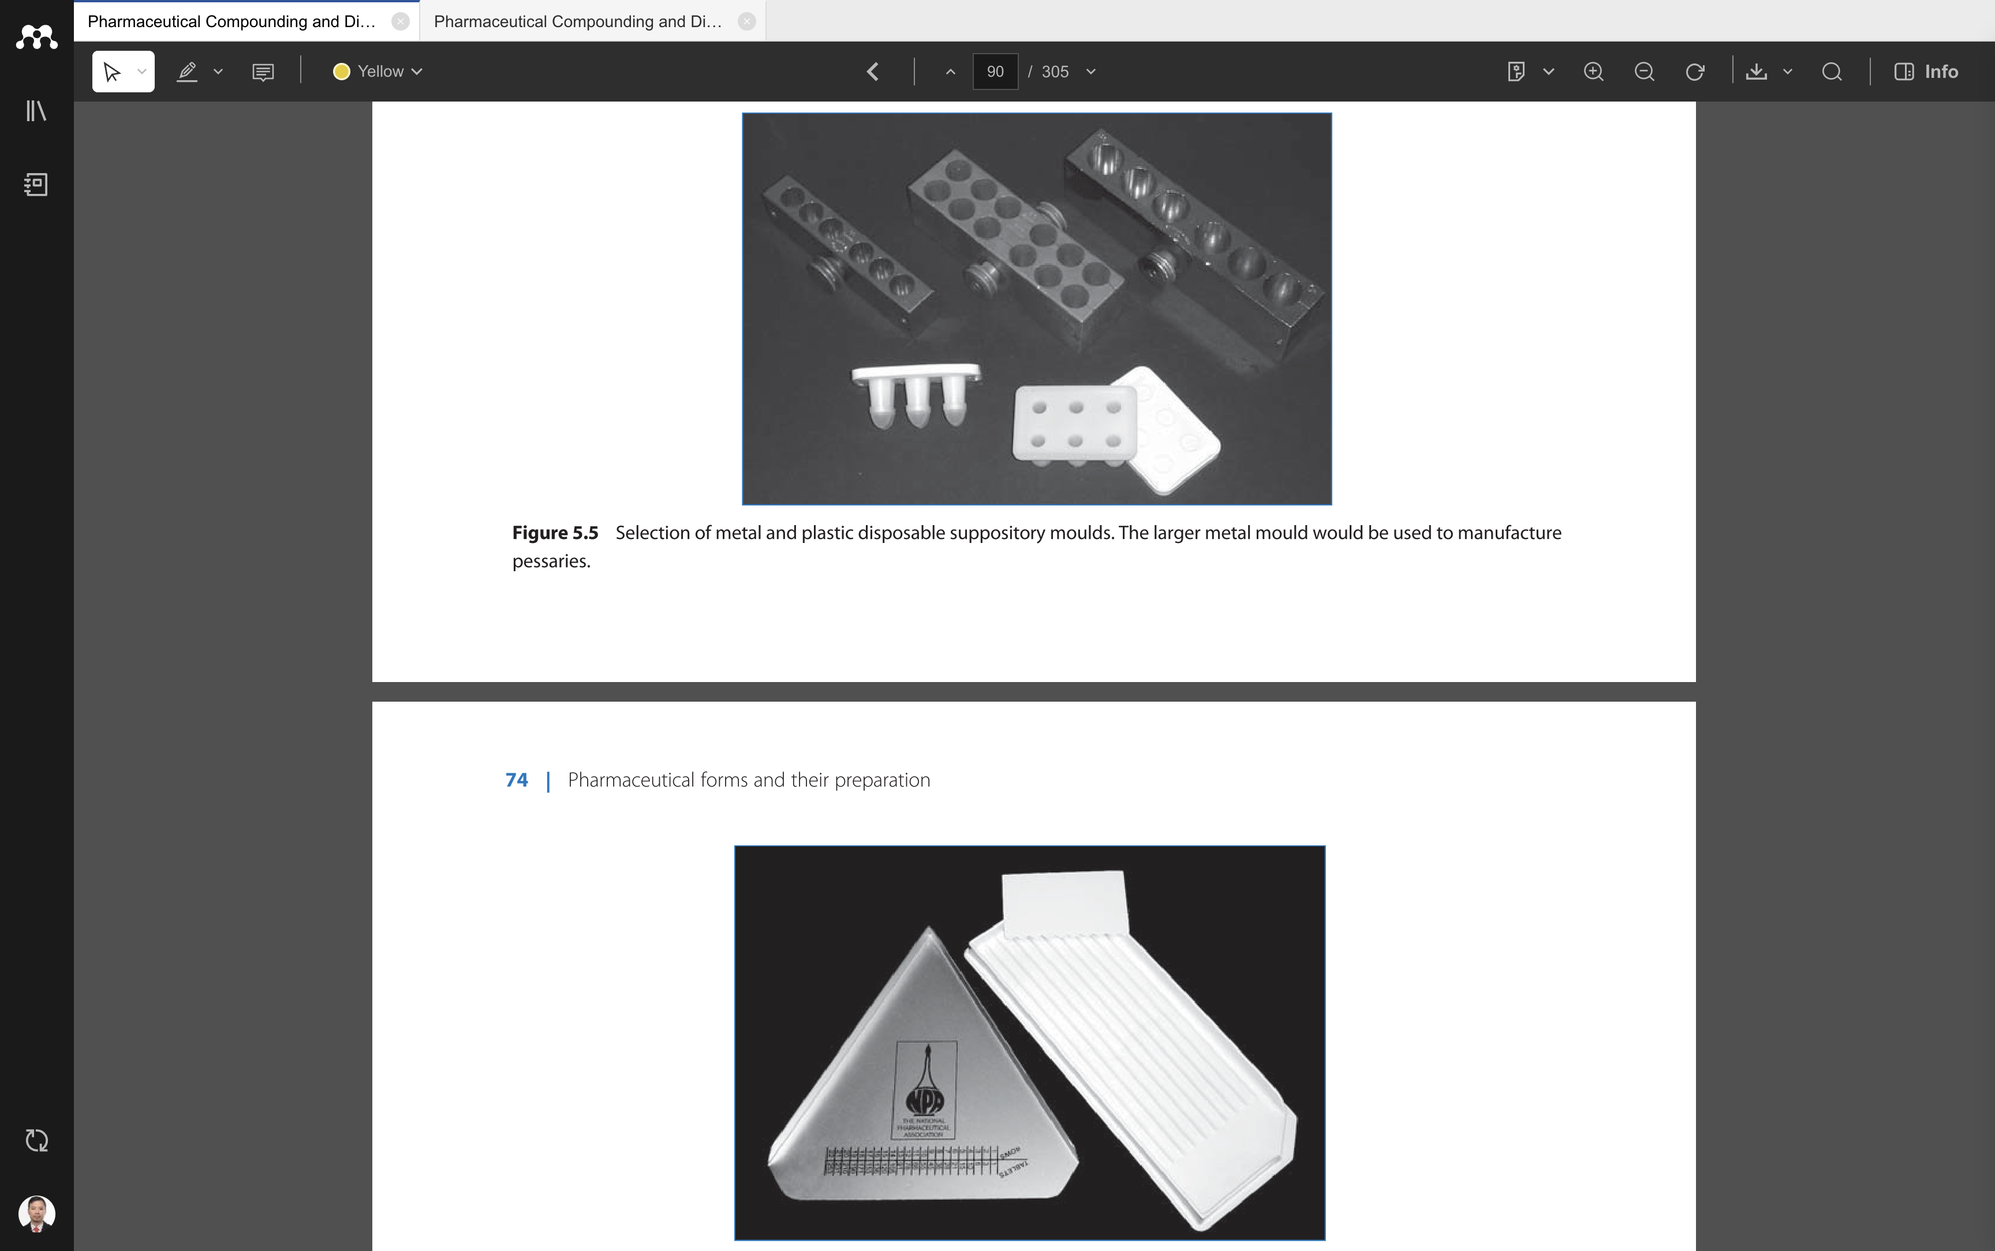
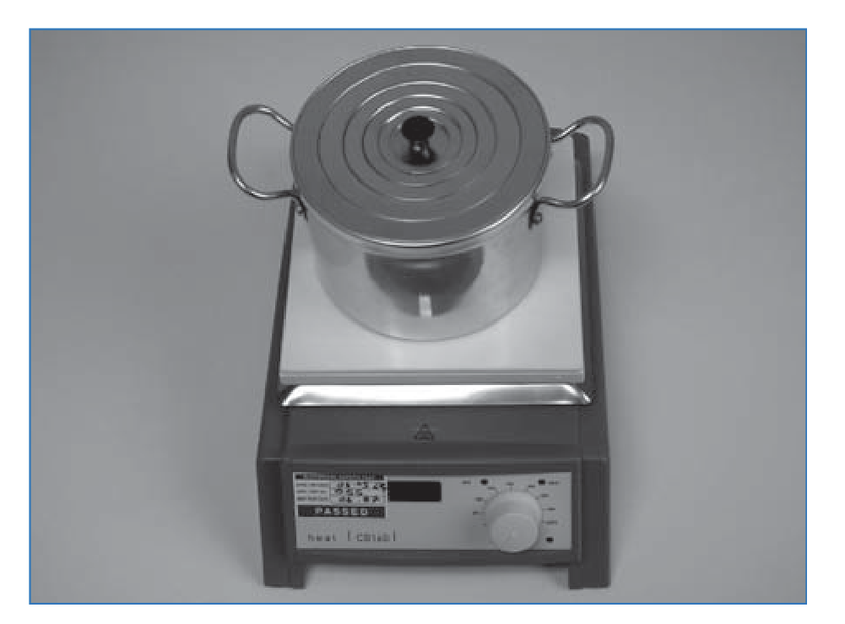
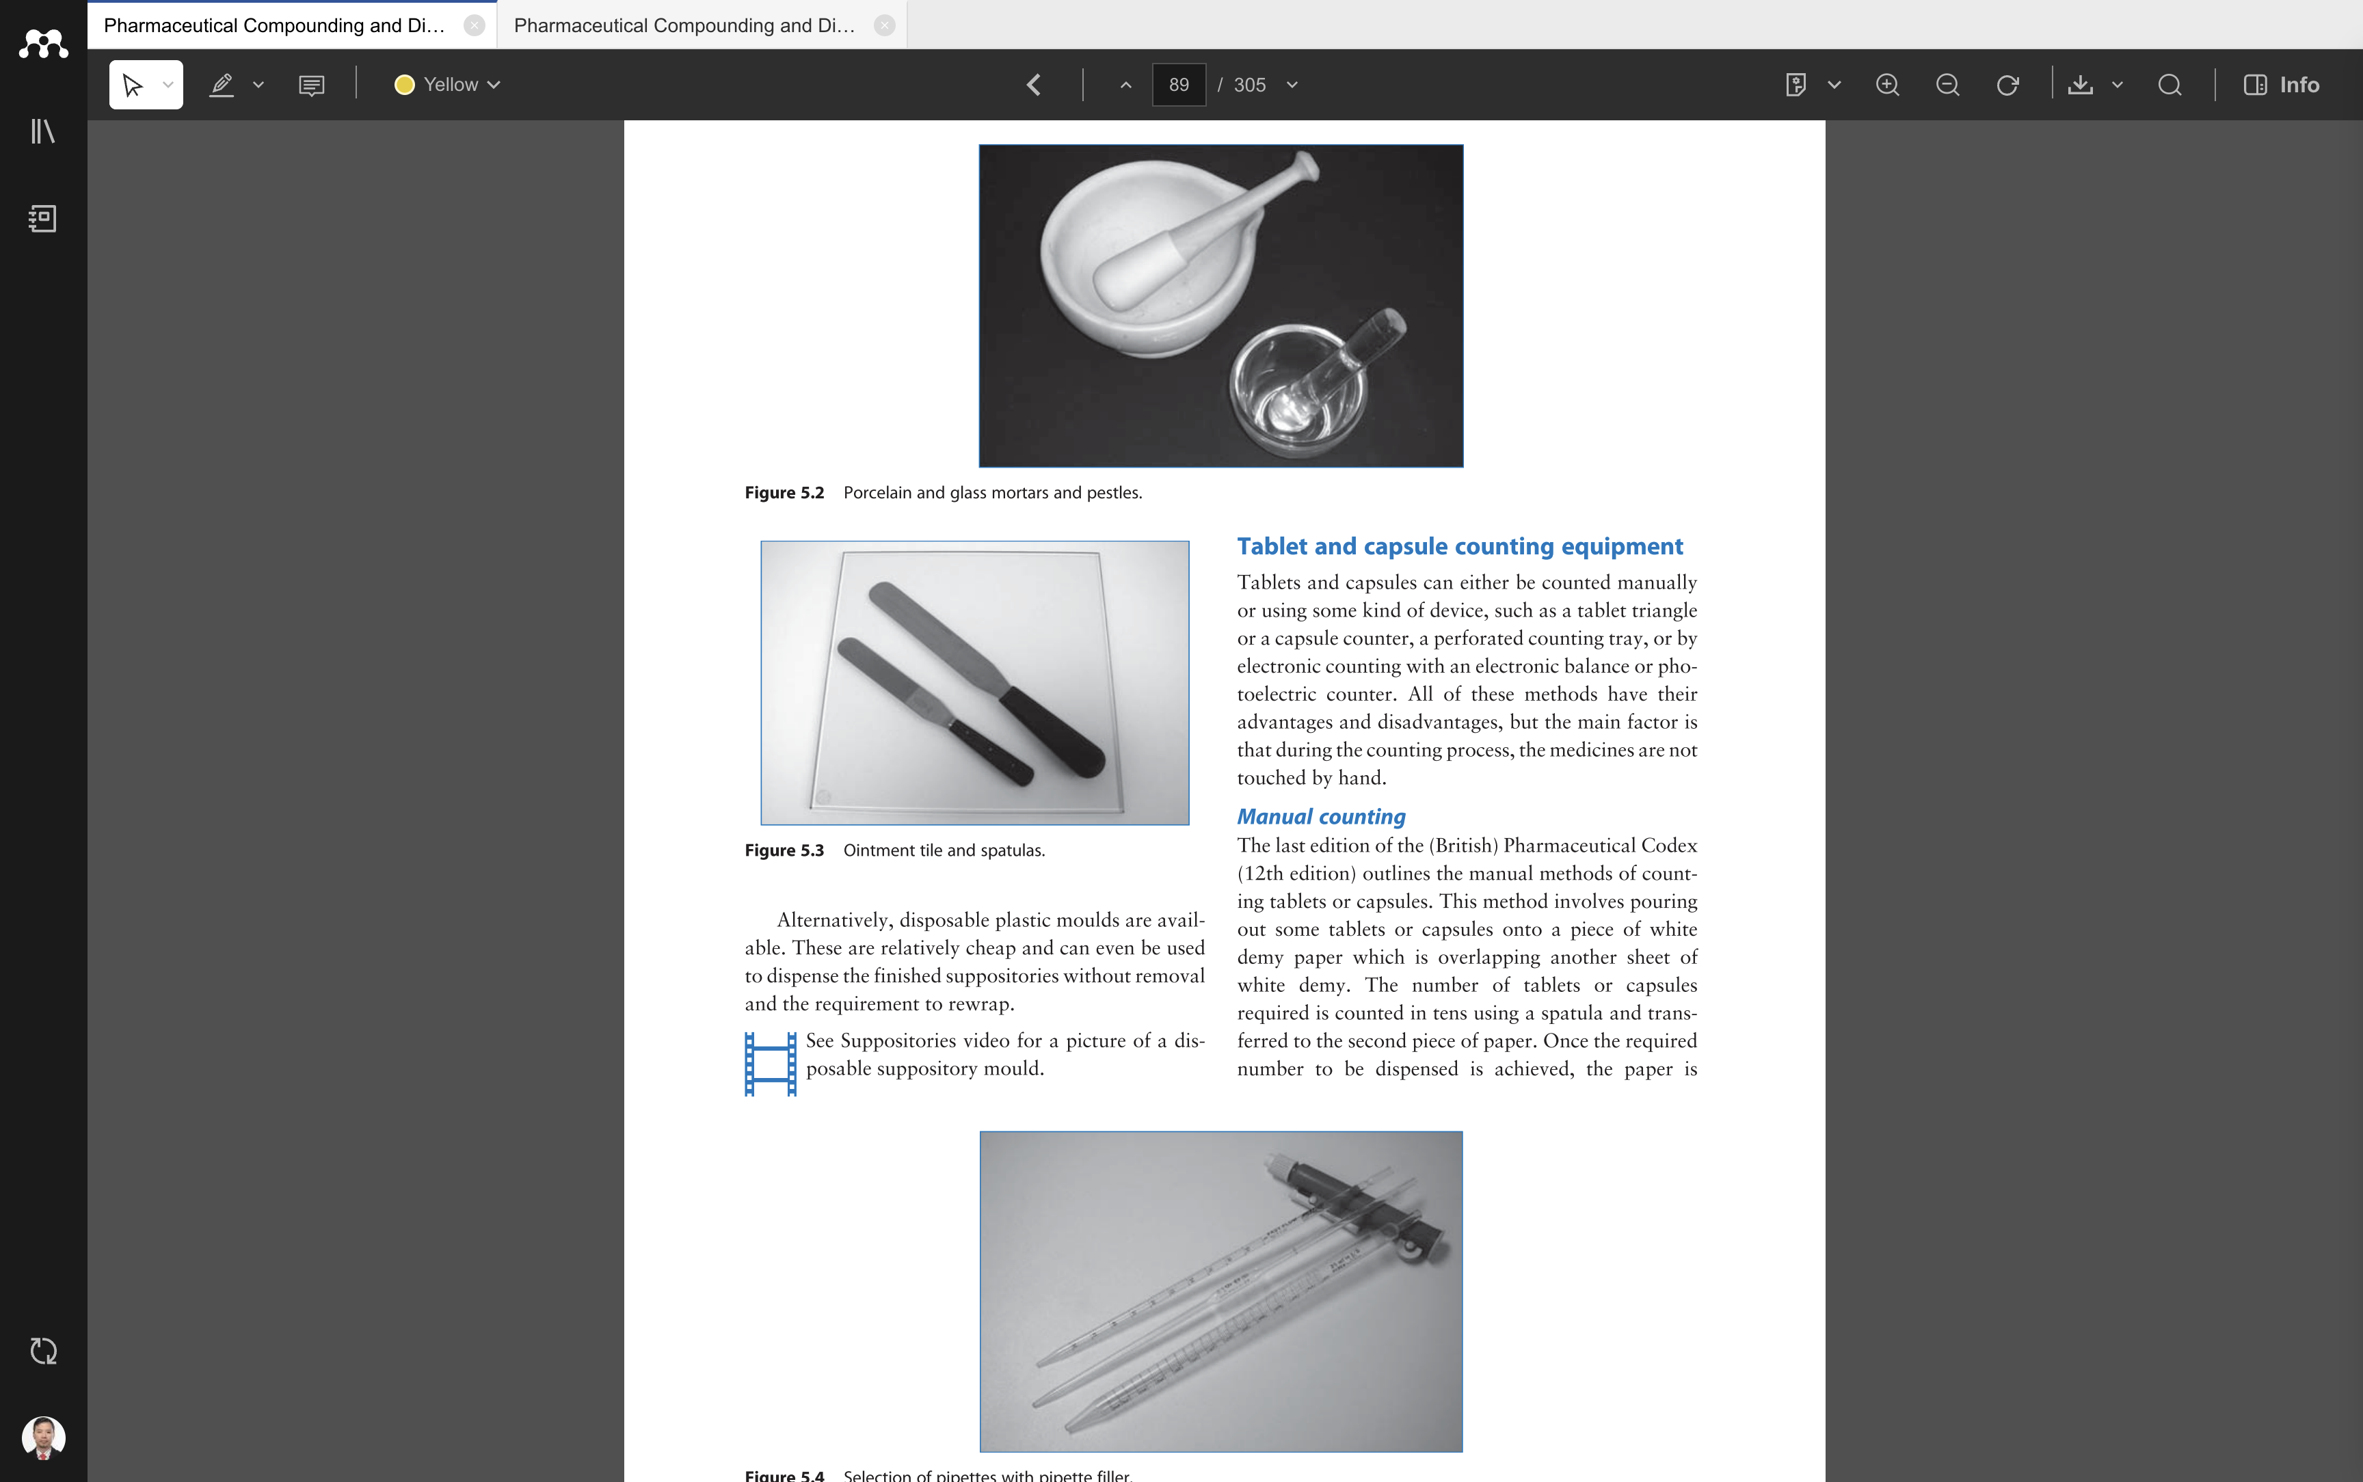

Slide 16
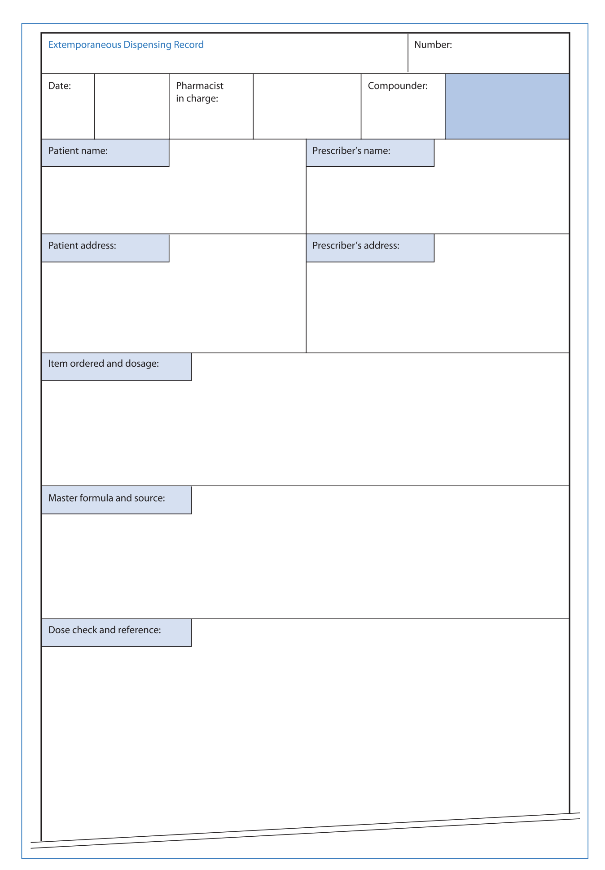

Slide 17
Good Pharmaceutical Practice
Recording
Cleanliness & equipment
Validity of the formula
Stability and storage

Slide 18
Packaging & Labeling
Containers according to the type of preparation
Labels contain rules of use
Expiration date
Safety information

Slide 19
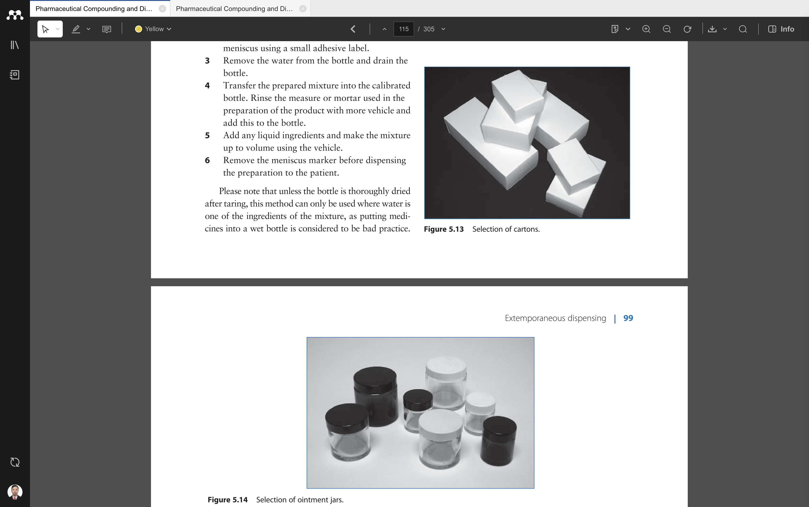
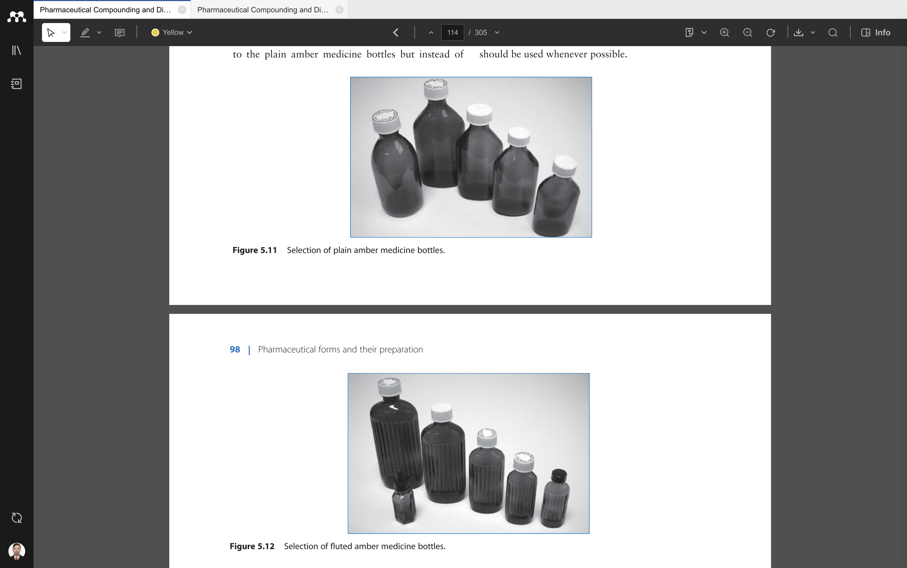
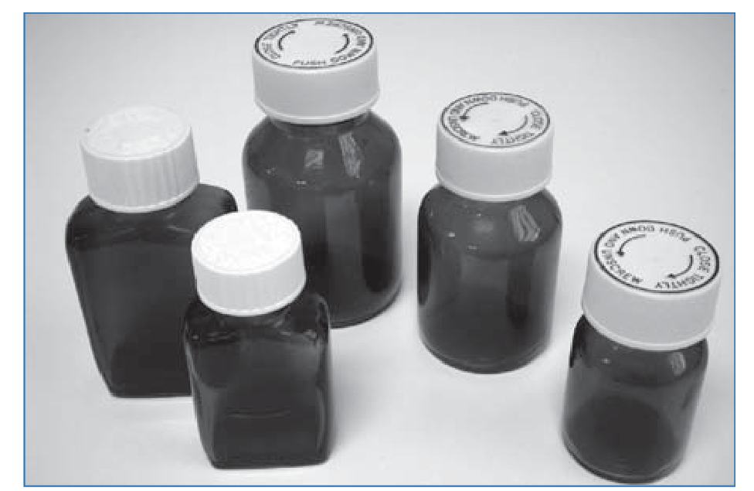

Slide 20
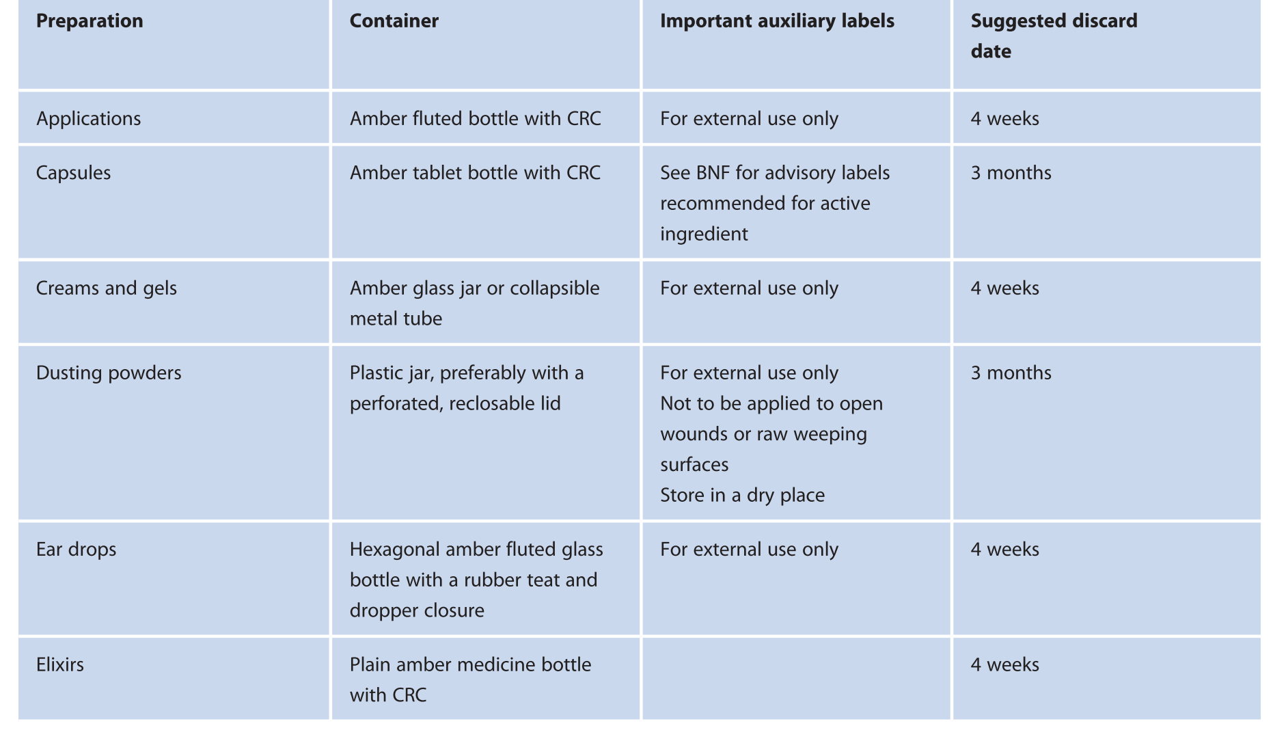
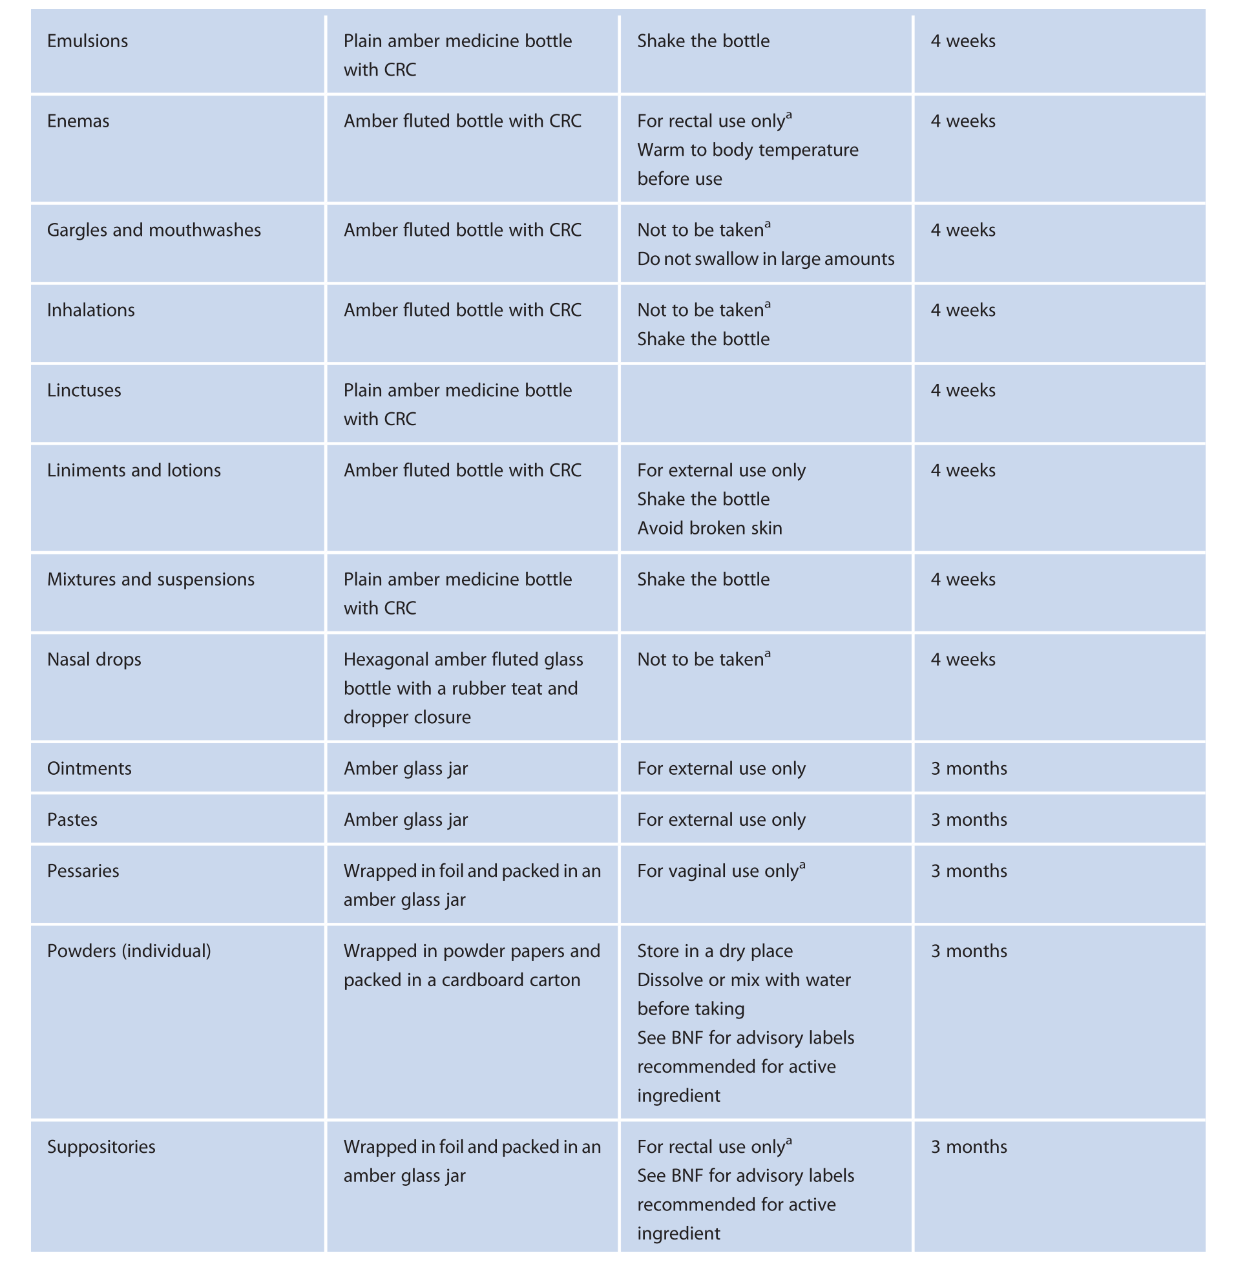

Slide 21
Reference
Marriott JF, Wilson KA, Langley CA, Belcher D. Pharmaceutical Compounding and Dispensing. Second edition. 2010.

Slide 22
Thank you

