Slide 1
DASAR DAN DINAMIKA PENGEMBANGAN MASYARAKAT

Slide 2
PENGEMBANGAN MASYARAKAT, PENYULUHAN PERTANIAN DAN PEMBERDAYAAN
Pengembangan Masyarakat (Community Development)
Outreach
Mechanism
Agriculture
Extension
Empowerment
Communication
(Disseminastion)
(Eropa)
Education
(Diffusion-Adoption)
(Amerika)
Fungsi dari:
Otoritas, Sumberdaya,
Informasi,
dan Akuntabilitas
Definisi, Proses,
Dan Falsafah
Definisi, Proses,
Dan Falsafah
Definisi, Proses,
Dan Falsafah

Slide 3
Pengembangan Masyarakat dalam Konteks Pembangunan Daerah
Tingginya ketergantungan pembangunan daerah kepada pusat dapat menghilangkan kemandirian daerah
Pembangunan daerah memerlukan importation of energy dari masyarakat
Mengembangkan potensi yang ada di masyarakat pada tingkat lokal dan komunitas akan sangat berarti dan dapat menjadi basis pertumbuhan dalam aktivitas pembangunan daerah

Slide 4
COMMUNITY DEVELOPMENT AND BUSINESS

Slide 5

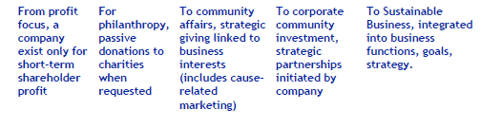
COMMUNITY DEVELOPMENT AND BUSINESS:
Business Evolution toward Sustainability
Diadaptasi dari Fajar (2006)

Slide 6
COMMUNITY DEVELOPMENT AND BUSINESS:
Goals of Corporate Investment
As expectations on return on CSR investment increase, companies tend to gravitate towards transformational partnerships that leverage core business.
Goal
Activity
Doing good
Grants/ GIK
Improve image at community, national and employee levels
  Engage in times of disaster
  Donate cash / goods
  Fund programs around operations
Philanthropy
Capabilities Partnerships
Heighten employee morale and skills
Contribute as a business to social goals
  Support community projects and voluntary work, offer expertise, technologies and social marketing
  core skills, resources
Social Investment
Reach new markets & revenue streams through new products / services
Increase consumer loyalty
  Develop pro-poor products, services and supply chains, and inclusive business models
Transformational Partnerships
Commercial Initiatives
Doing business
Comply with regulations
Meet requirements for ‘local content’
Ensure sustainability in supply and distribution
  Local supplier enterprise development
  Ethical supply (e.g. human rights/ labor policy)
Core Business
Size of Investment
Source: World Vision
Notes:
6
6

Slide 7
COMMUNITY DEVELOPMENT AND BUSINESS:
CSR : The Triple Bottom-line Approach
Brand Equity
Improving the Quality of Life
Synchronizing
Triple bottom line for
Sustainable Development
Adding
Economic Value
Harmonizing
Environmental Factors
Building Social
Capital in the Community
INCOME
GENERATION
ENERGY
MANAGEMENT
NR MANAGEMENT
ENVIRONMENT
CONSERVATION
HEALTH ,
EDUCATION
&
INFRASTRUCTURE

Slide 8
COMMUNITY DEVELOPMENT AND BUSINESS:
Convergence of Interests
Pure Philanthropy
Combined Social
and
Economic benefits
Social Benefits
Pure Business
Economic Benefits

Slide 9
COMMUNITY DEVELOPMENT AND BUSINESS: Corporate Social Responsibility
The World Business Council for Sustainable Development
"Corporate Social Responsibility “is the continuing commitment by business to behave ethically and contribute to economic development while improving the quality of life of the workforce and their families as well as of the local community and society at large.
The World Bank Group
“Is the commitment of business to contribute to sustainable economic development working with employees and their representatives, their families, the local community and society at large to improve quality of life, in ways that are both good for business and good for development”
Indonesian Business Link
“CSR is a concept whereby companies integrate social and environmental concerns in their business operations and in their interaction with their stakeholders on a voluntary basis
CEO Forum on CSR in Indonesia
“The concept of CSR goes beyond philanthropy and paying taxes, it is about investing in sustainable development and the empowerment of communities. It is not only about external stakeholders but actively involves the internal stakeholders as well.”

Slide 10
COMMUNITY DEVELOPMENT AND BUSINESS:
Why CSR?
Government’s Regulation
  Bill passed on July 20, 2007 as Limited Liabilities Companies Act No. 40, Article 74:
    A Limited Liability Company is obligated to conduct corporate social responsibility and environmental responsibility
    Corporate social and environmental responsibility is an obligation for Limited Liability Companies, which is budgeted and calculated as cost or expense for Limited Liability Company
    A Limited Liability Company that does not carry out the obligation shall be sanctioned according to regulations
Building and Enhancing Corporate Image
  In 2006, 12 companies issued stand-alone sustainability CSR reports to their annual financial reports
Company’s Culture
Crisis Management

Slide 11
COMMUNITY DEVELOPMENT AND BUSINESS:
Jebakan Aktivitas CSR Perusahaan
No free lunch: image and reputation, jika mungkin dampak langsung untuk bisnis
Avoid conflict: cenderung akomodatif dan “mengumbar” janji
Find the easiest way: mengalokasikan uang/anggaran atau memberi philanthropy
Quick result: ditujukan kepada pengembangan ekonomi individu, bukan community
Hanya melaporkan successful story
Hit and run

Slide 12
Key Actors of CSR
Agents
Private
Sector
CSR
Civil
Society
Government
Watchdogs
Law makers
Communities
Owners

Slide 13
Pergeseran Makna Partisipasi dalam CSR (Dari community participation ke stakeholder participation)
KebijakanCSR
2
Partisipasi
Program CSR
1
Partisipasi
Partisipasi
1
Pemerintah
Swadaya Masyarakat
Respon Masyarakat
Masyarakat
2
Perusahaan
Community Participation
Stakeholder Participation

Slide 14
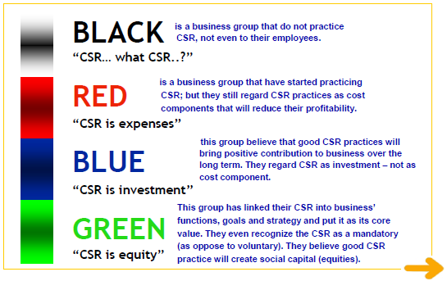
COMMUNITY DEVELOPMENT AND BUSINESS:
Spectrum of CSR

Slide 15
COMMUNITY DEVELOPMENT AND BUSINESS:
ISO 26000 (Corporate Social Responsibility)
Stakeholder Engagement
7 Principles of Social Responsibility
(1) Accountable for its impact on society and the environment; (2) transparent in its decision and activities that impact; (3) behave ethically at all times; (4) respect and consider the interesets of its stakeholders; (5) respect the rule of law; (6) recognize both the importance and the universality of human rights; (7) respect relevant international norms where these norms are superior to national law and practice
Core Issues
Organizational Governance
Human Rights
Labor Practices
Environment
Fair Operating Practices
Consumer Issues
Sos & Ec Development
Implementing Social Responsibility
Understanding
Enhancing Credibility
Implementing
Social Responsibility
Working with Stakeholders
Assesing
Integrating
Communicating
Implementing
Stakeholder Engagement
Diadaptasi dari Prasetijo (2010)

